Slide 1

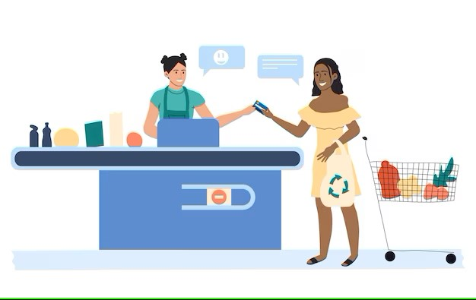

Supermarket Sales
By:
Haidy Fathy Fatma Samir
Yassmin Mostafa

Slide 2
Introduction
This project focuses on analyzing supermarket sales which is assisted by its branches dataset that includes some of the customers’ purchases.

Slide 3
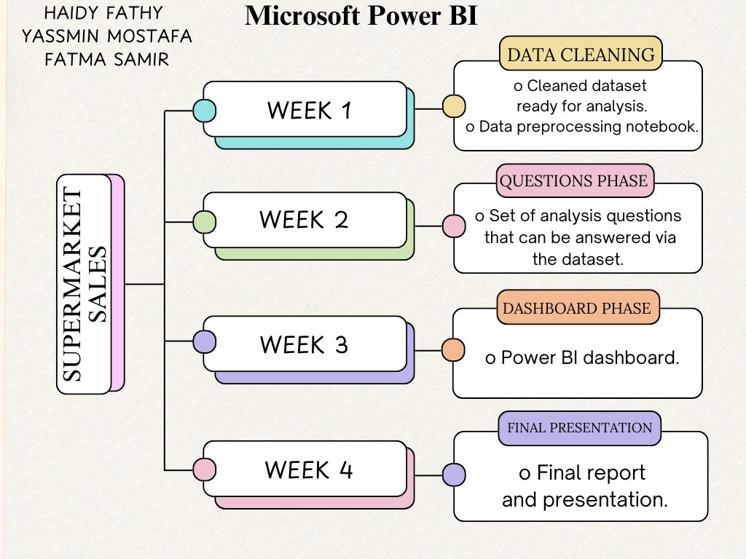
Project Roadmap

Slide 4
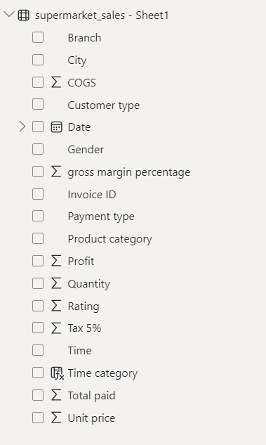
Data overview
COGS: cost of goods sold which is the cost of production of the purchased items.
Tax 5%: it is the tax paid which is 5% of the total prices of the purchased items.
Total paid: it is the revenue of the products, or the amount of money paid by the customer.
Profit: it is the revenue excluding the cost, which gives the net profit earned by the company.
Gross margin percentage: it is the percentage of profit from the total revenue, which is a constant value.

Slide 5
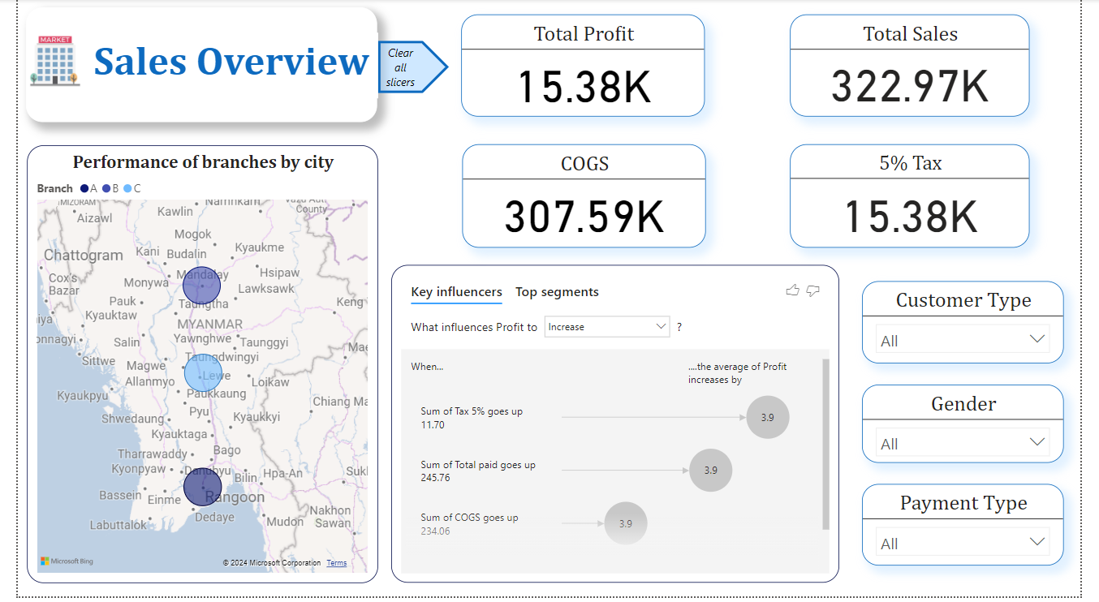
Overview Page

Slide 6
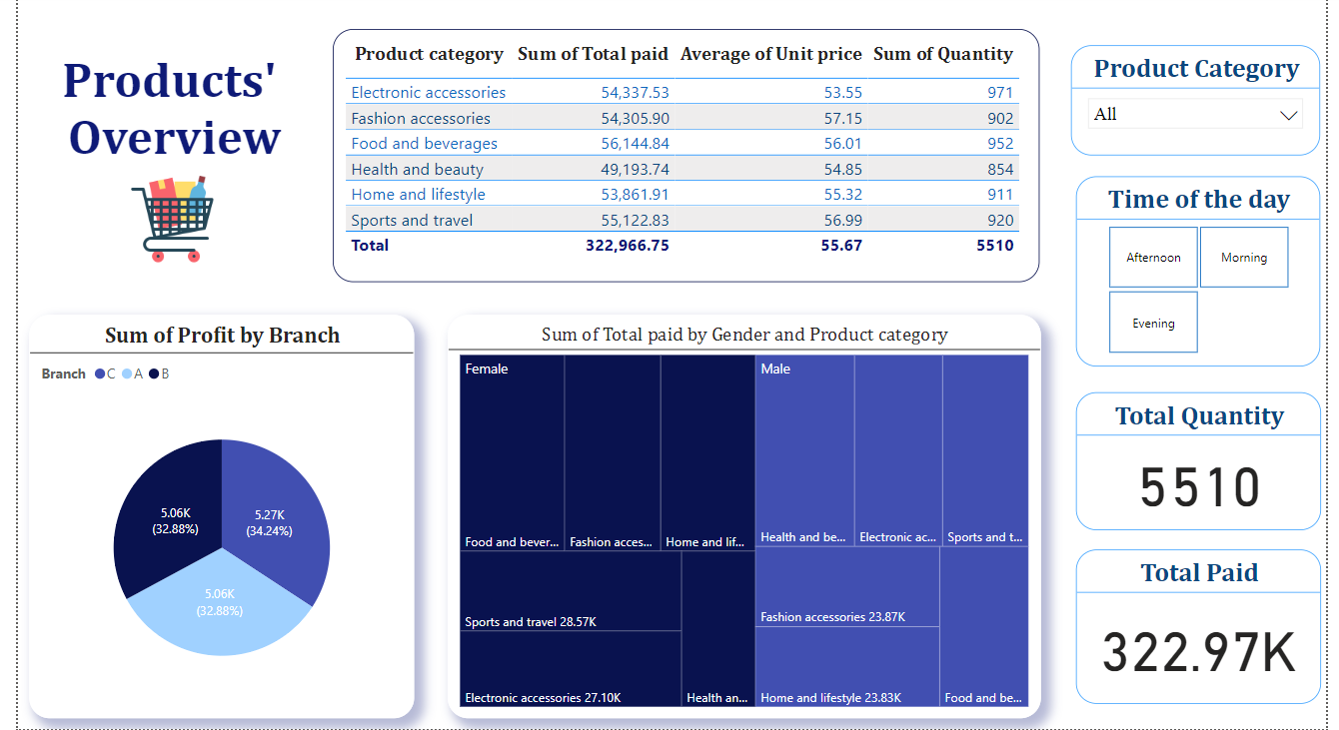
Products’ Overview

Slide 7
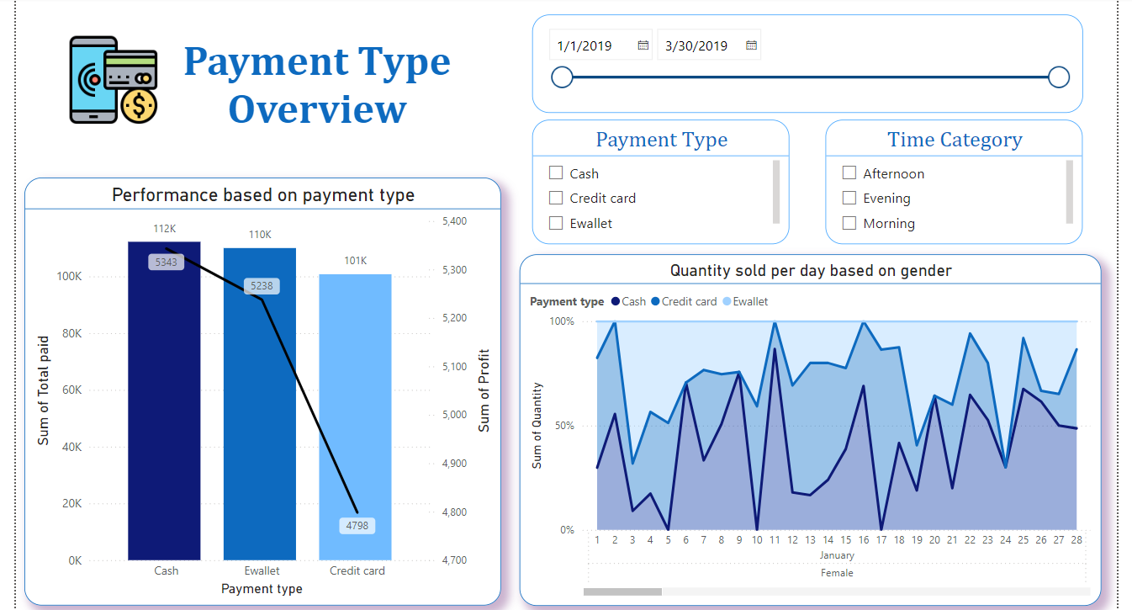
Payment Type

Slide 8
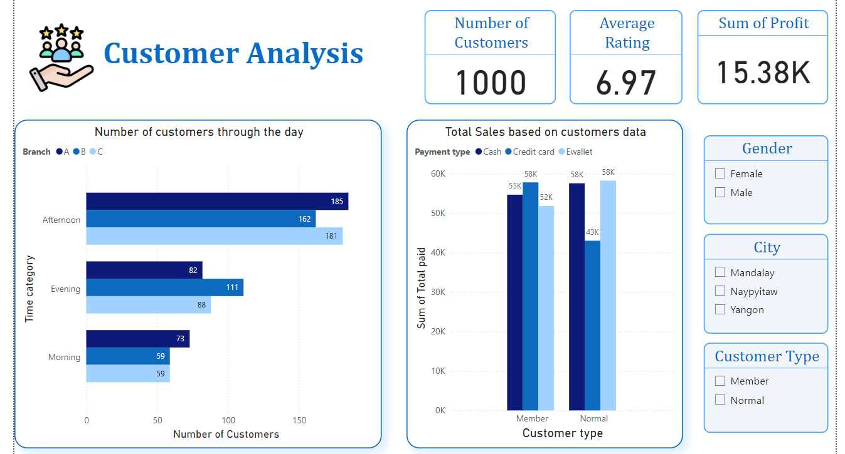
Customer Analysis

Slide 9
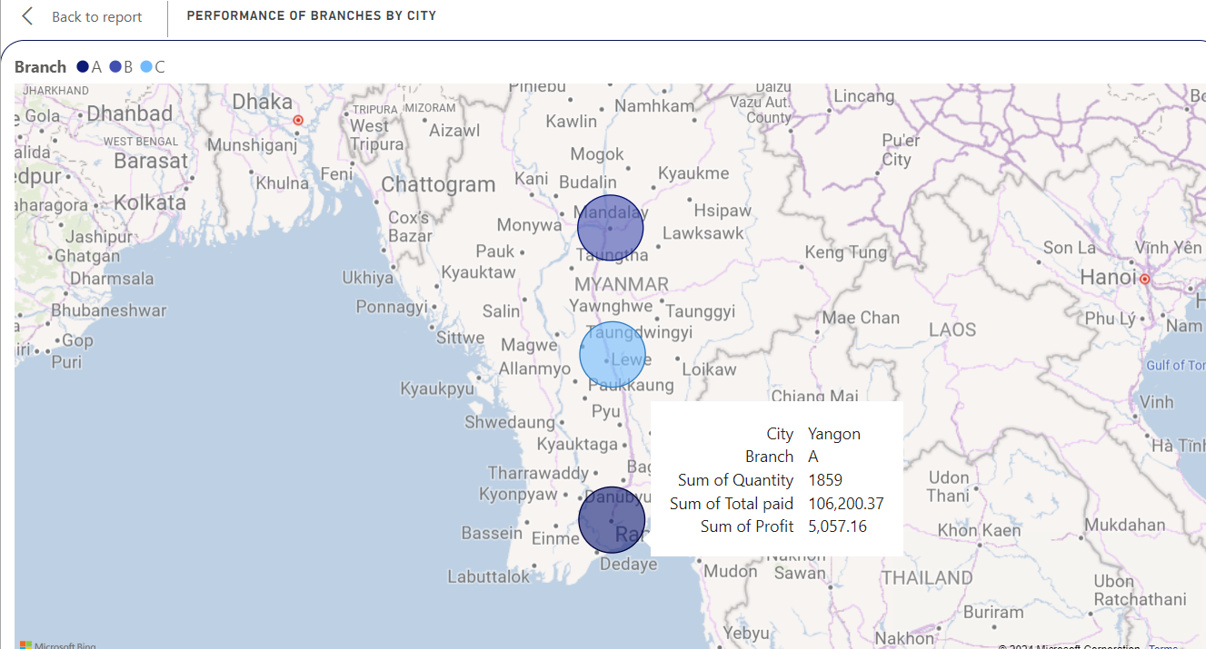
What is the general performance of each branch?

Slide 10
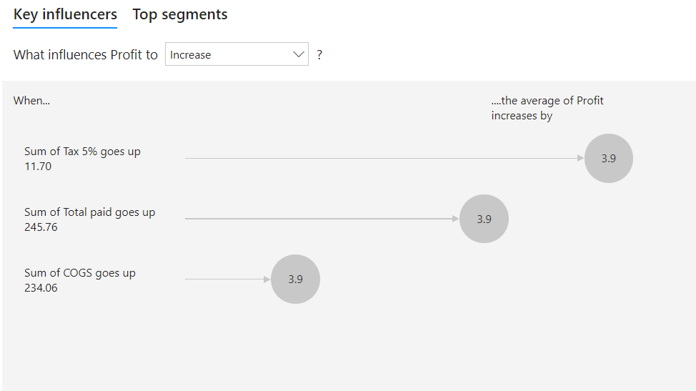
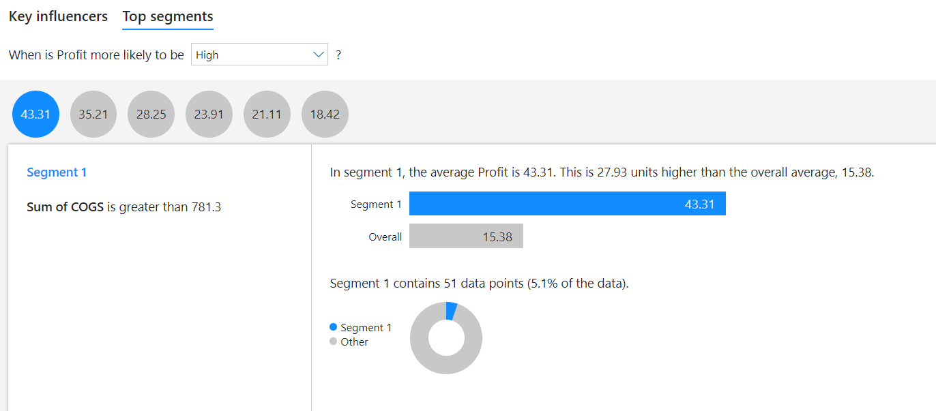
How to increase the profit from the customers?

Slide 11
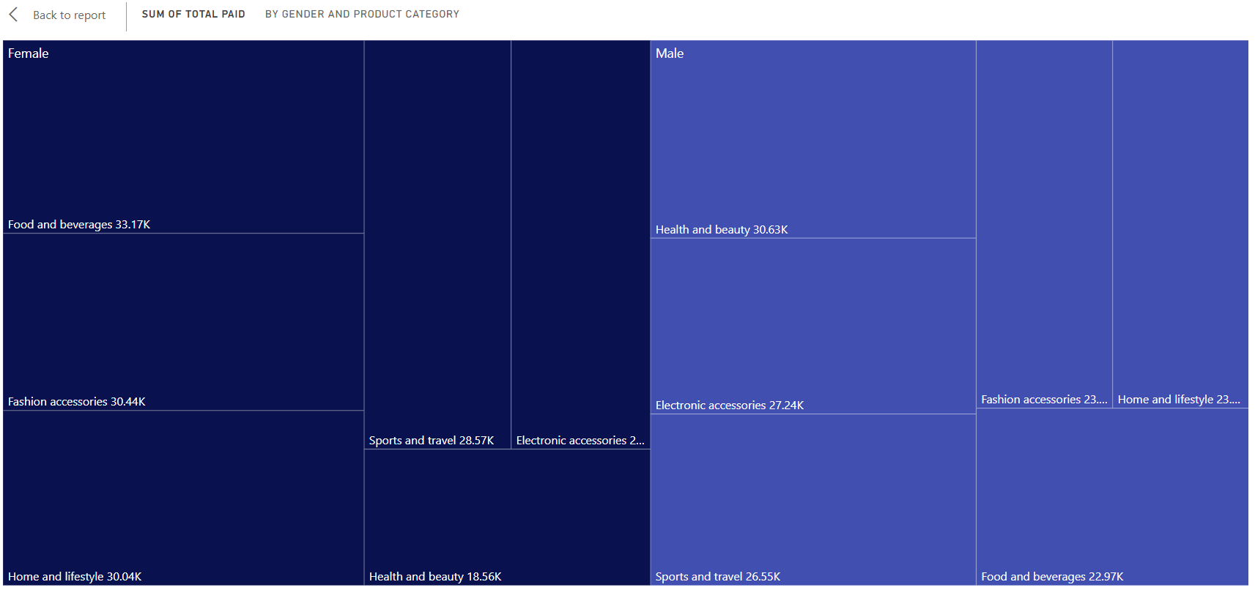
Does a specific gender have specific preferences in products?

Slide 12
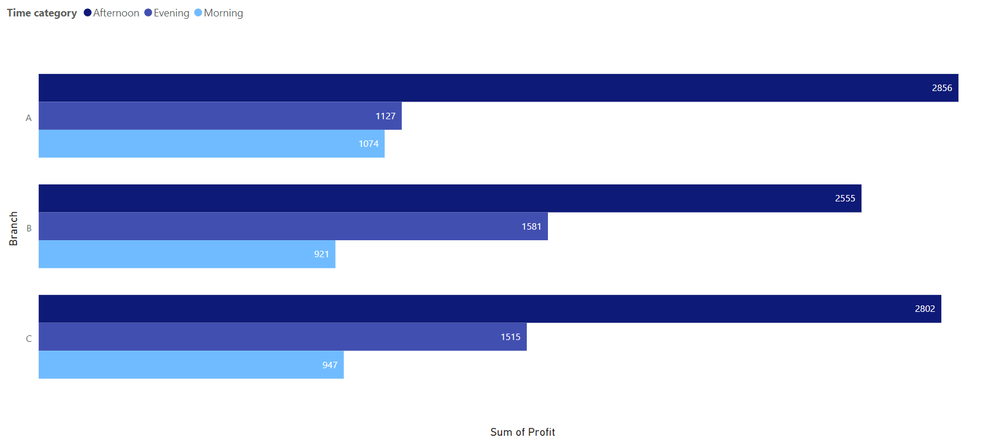
What time of the day has the highest performance?

Slide 13
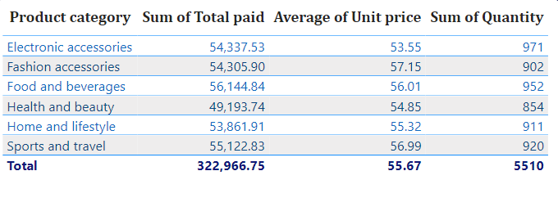
What products have the most popularity?

Slide 14
How does payment type affect sales?

Slide 15

Which payment type preferred by customers?

Slide 16
What specific times of the day have more congestion and how does it affect the sales?

Slide 17
Thank you

